Slide 1
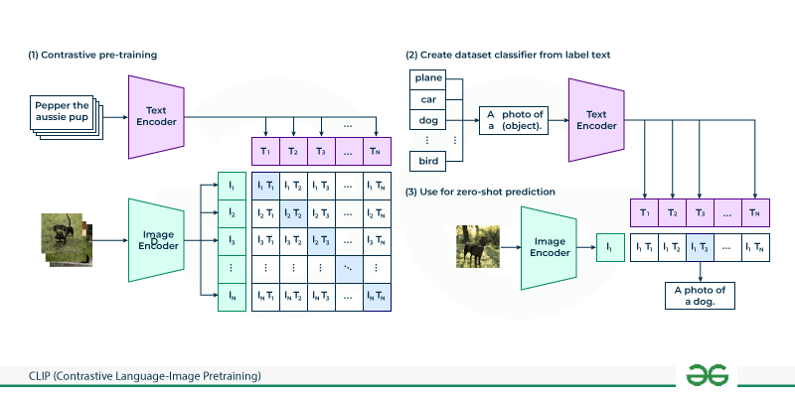
CLIP: The Bridge Between Pixels and Words
Developed by OpenAI, CLIP teaches AI to understand images by reading their captions.
It uses two encoders: one for images and one for text.
Contrastive Learning: The model is trained to "pull" matching image-text pairs close together in mathematical space while "pushing" non-matching pairs apart.
This allows for Zero-Shot Classification, where a model can identify an object it was never explicitly trained on simply by understanding the description.

Slide 2
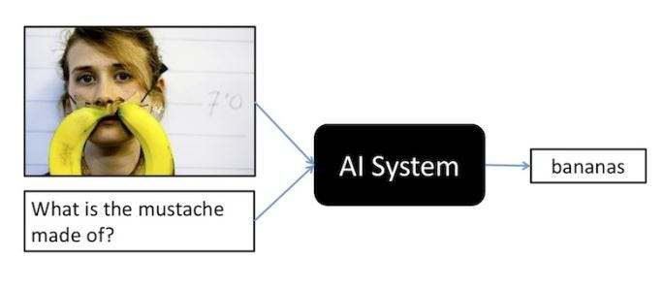
VQA: Conversing with Images
VQA allows models like GPT-4o or Llama-Vision to "see" an image and answer complex questions about it.
It’s not just tagging (e.g., "Dog"); it’s reasoning (e.g., "Is the dog's leash tied to the bench?").
Applications range from medical diagnostics (analyzing X-rays) to accessibility tools for the visually impaired.

Slide 3
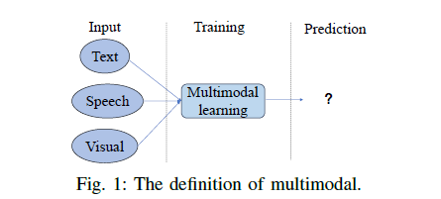
Multimodal Transformers: Shared Intelligence
A Multimodal Transformer processes both pixels and text tokens in the same mathematical "engine."
Images are broken into small "patches" (Visual Tokens), which the Transformer treats just like words in a sentence.
This unified architecture allows the model to find deep cross-modal relationships that traditional separate models would miss.

